Slide 1
The Create Task

Slide 2
Create Task
Written in Python on JuiceMind or use Processing
Game, application, data analysis, or mathematical simulation.

Slide 3
Programming is a collaborative and creative process that brings ideas to life through the development of software. In the Create performance task, you will design and implement a program that might solve a problem, enable innovation, explore personal interests, or express creativity. Your submission must include the elements listed in the Submission Requirements section below.
You are allowed to collaborate with your partner(s) on the development of the program only. The video and Personalized Project Reference that you submit for this performance task must be completed individually, without any collaboration with your partner(s) or anyone else. You can develop the code segments used in your Personalized Project Reference with your partner(s) or on your own as you work on the performance task during class.
Note: Because of all of the citation requirements, I recommend that you work on this task individually. If the program you are writing requires help from others, consider something simpler!

Slide 4
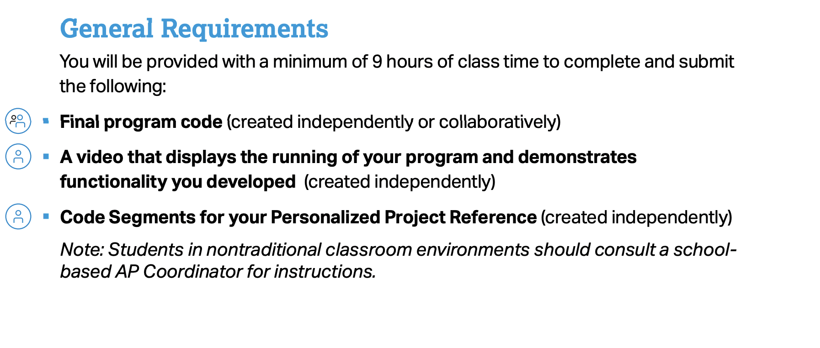
Requirements

Slide 5
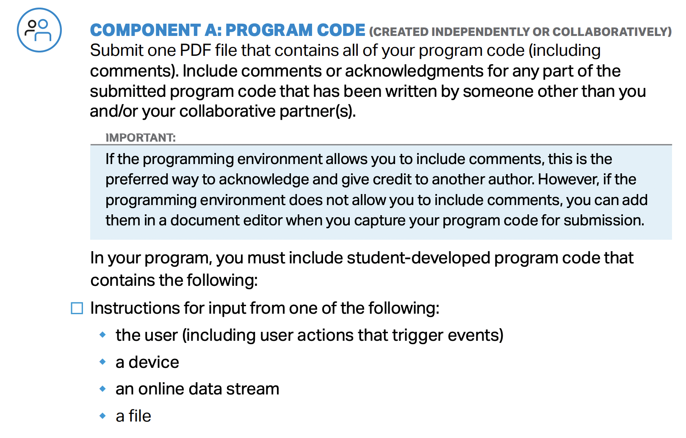

Slide 6
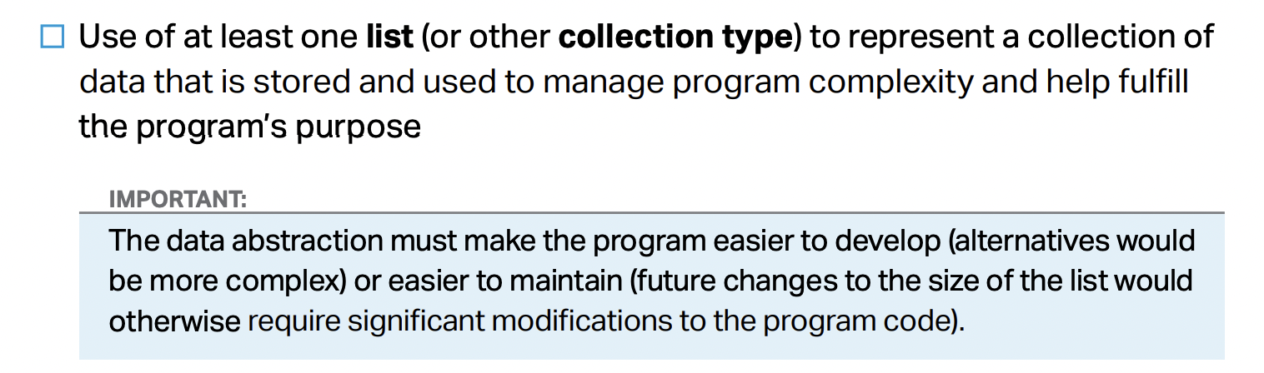

Slide 7
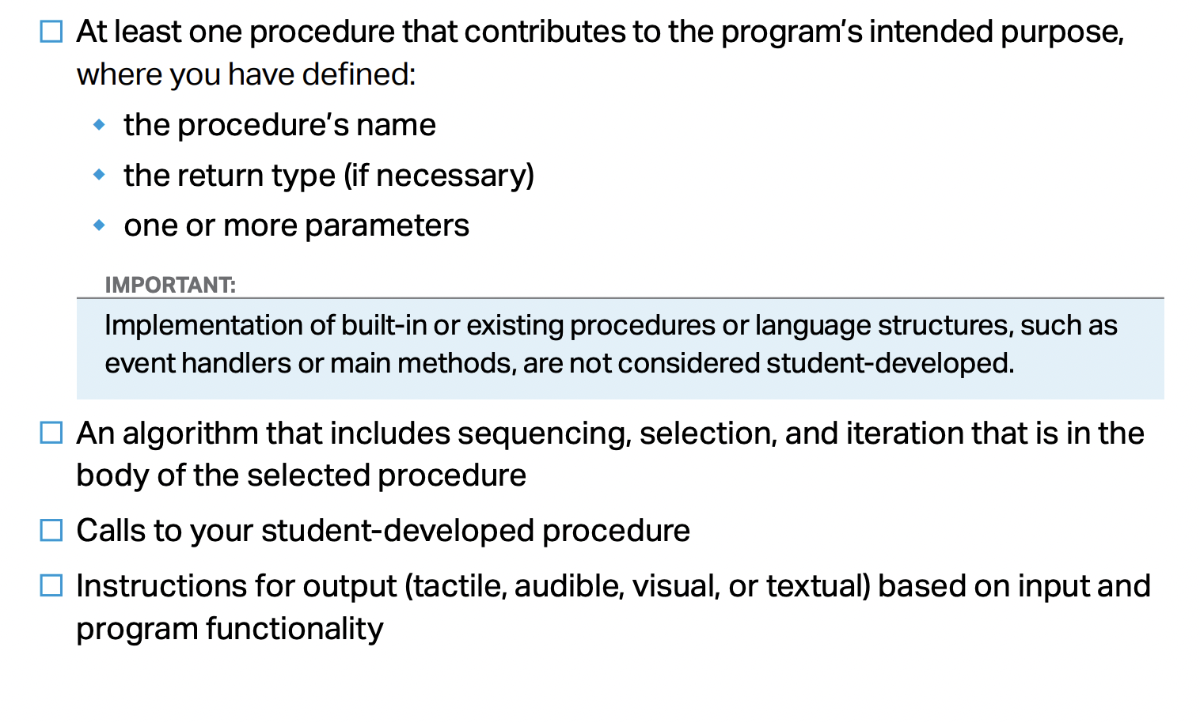

Slide 8
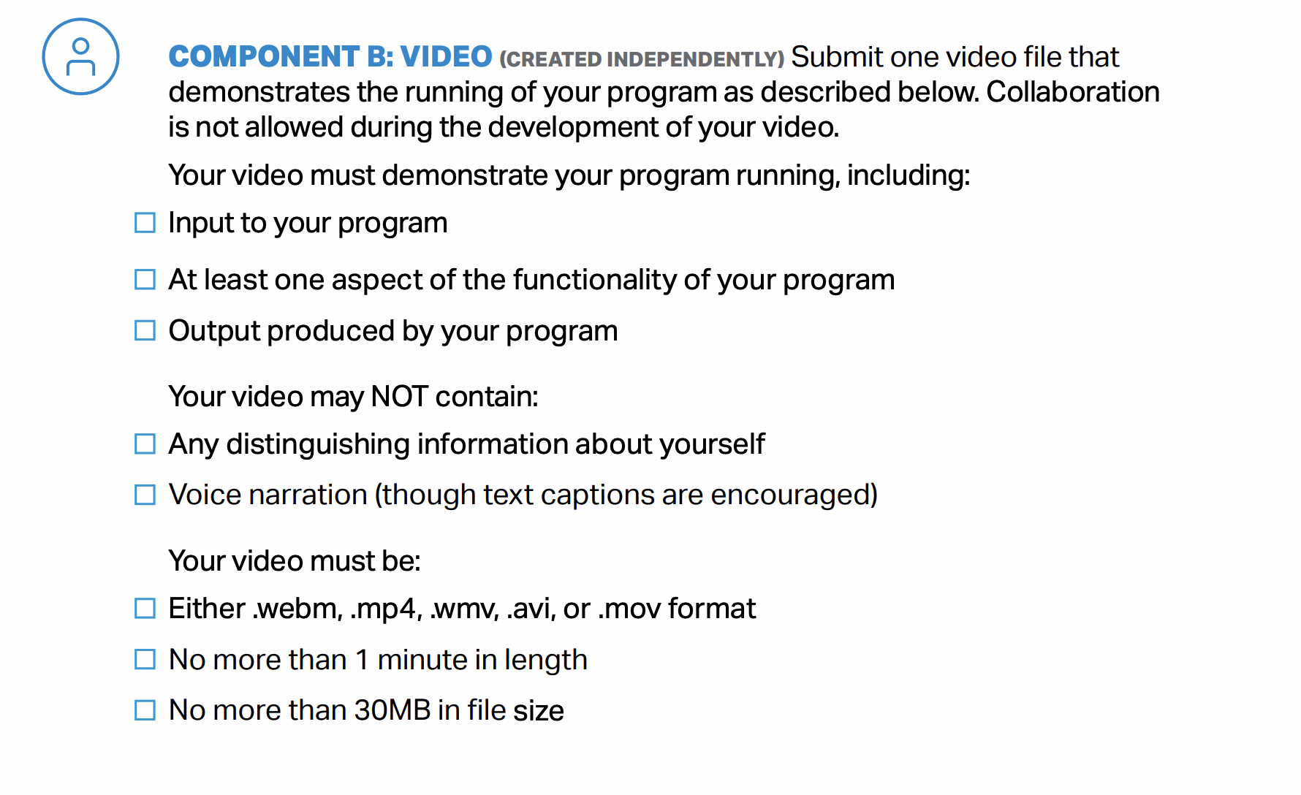

Slide 9
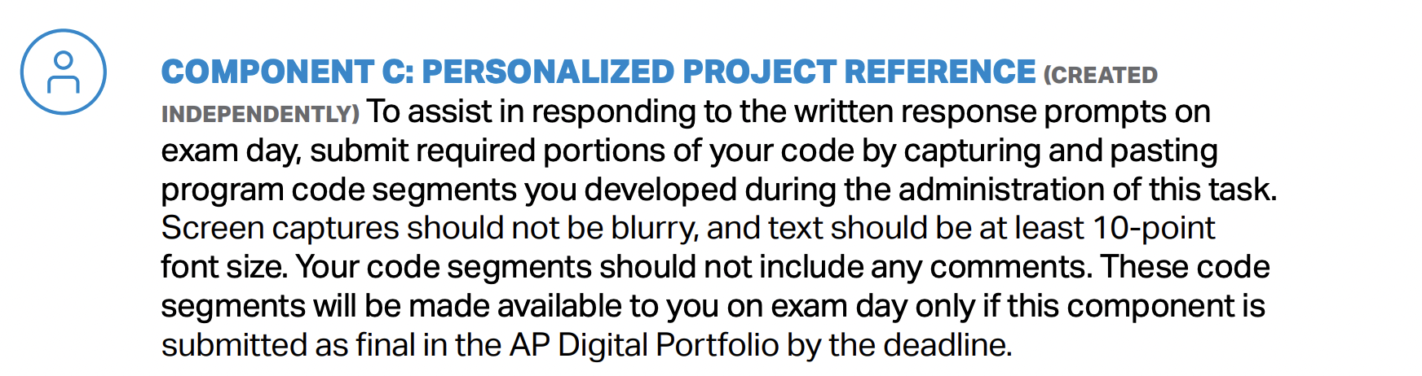

Slide 10
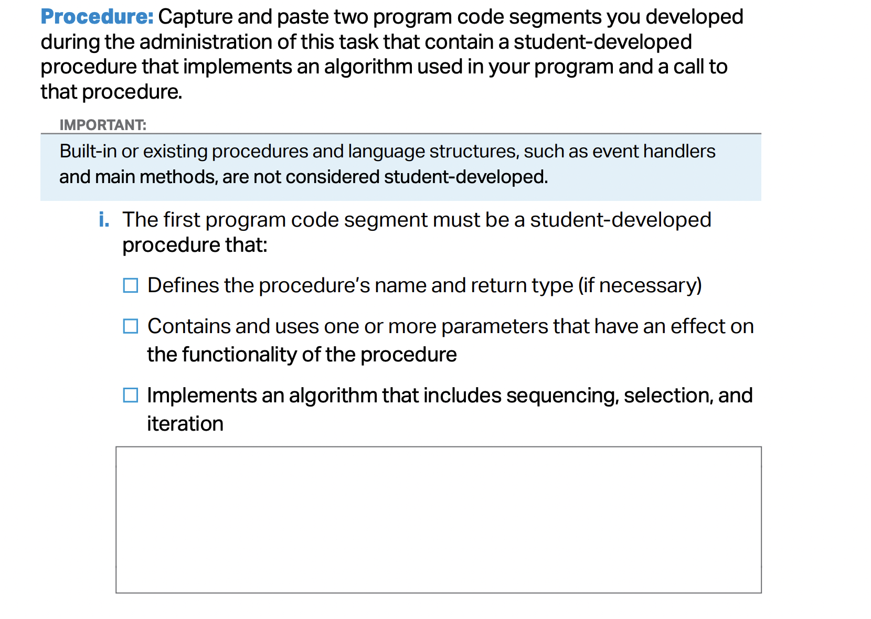

Slide 11
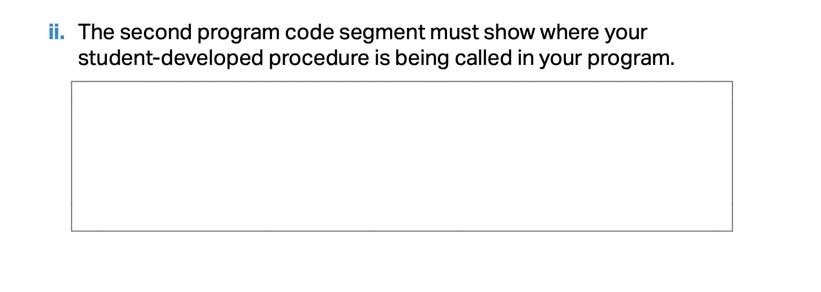
Procedure

Slide 12
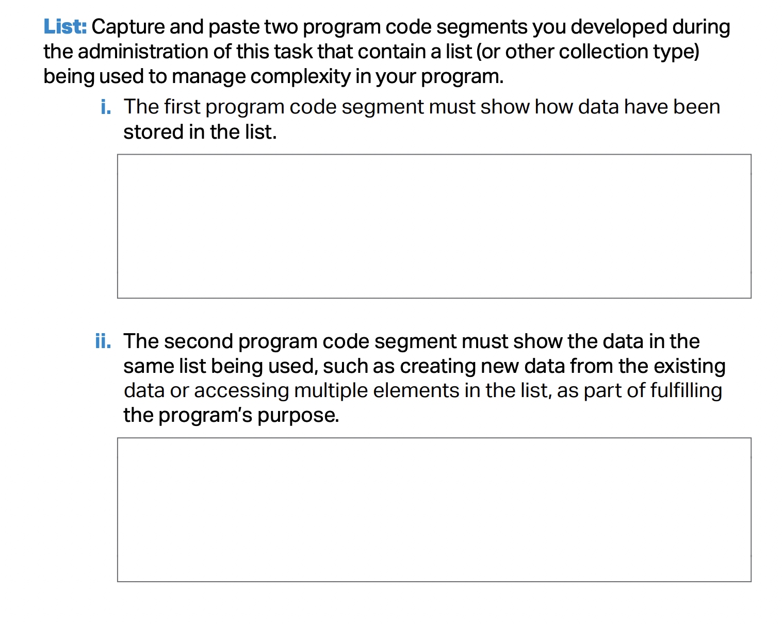

Slide 13
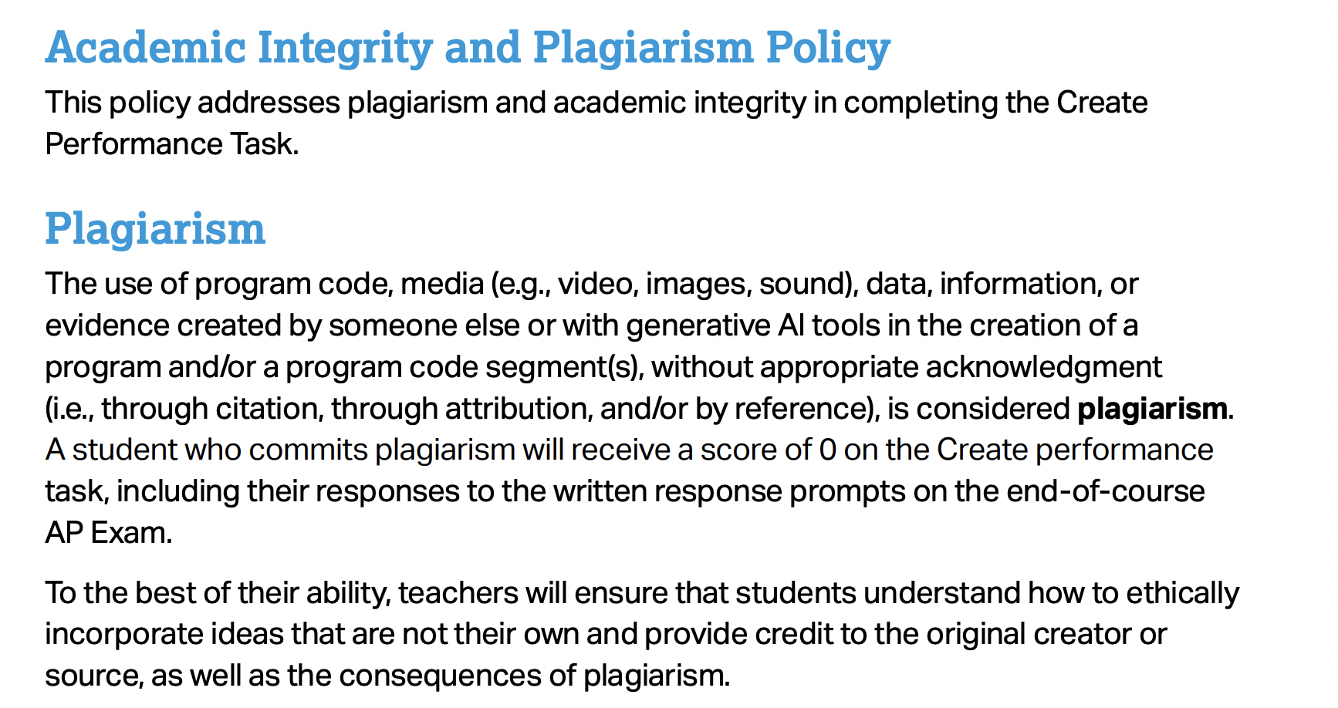

Slide 14
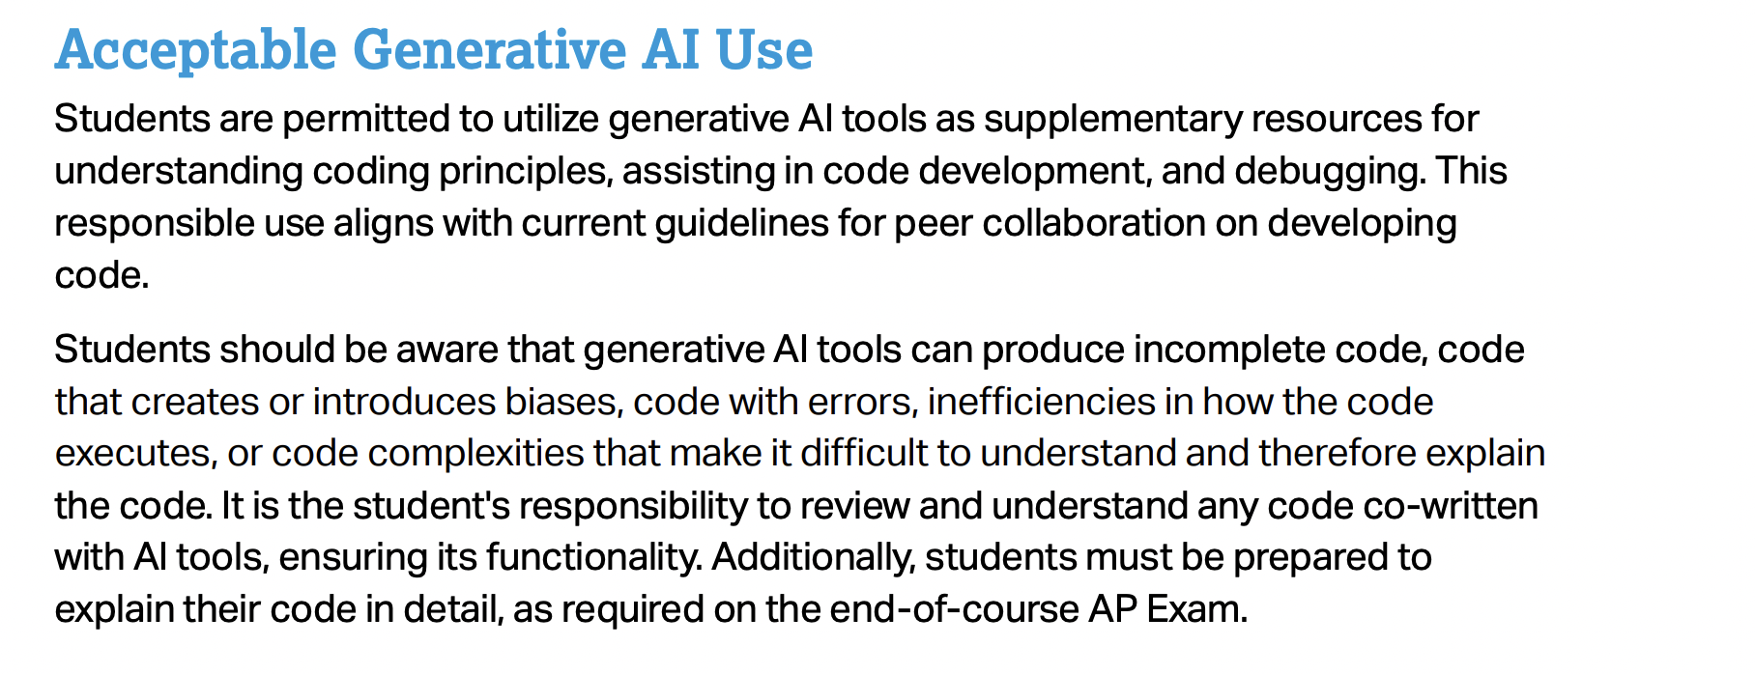

Slide 15
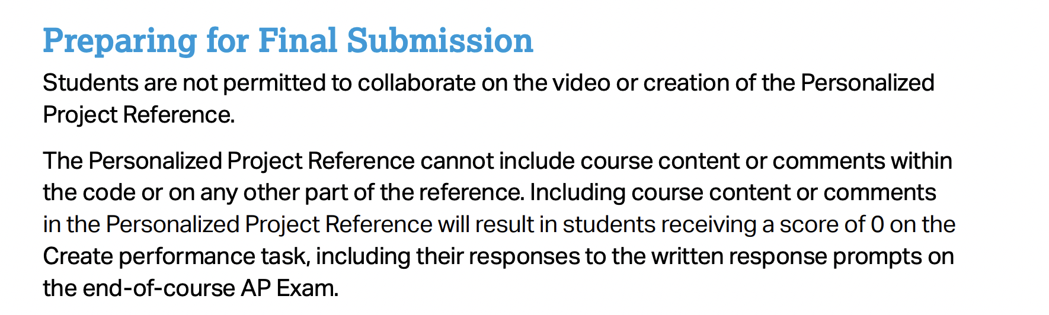

Slide 16
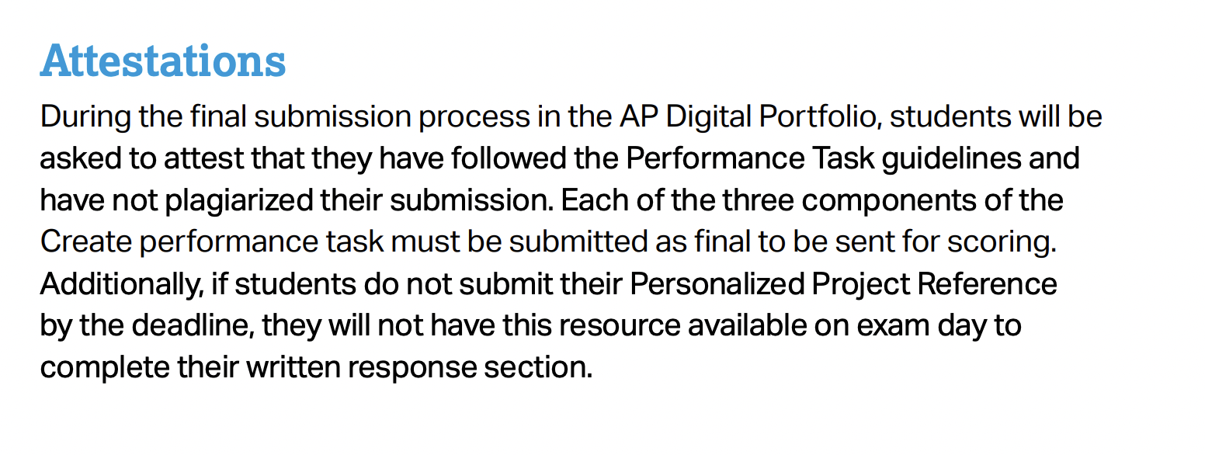

Slide 17
If there is a game that you have always wanted to write, DON'T do it for the create task!
The create task should be as minimal as possible, satisfying all of the requirements and tailored to answer the free response questions!
As we'll see from the examples this week, it can be a very simple program.

Slide 18
Steps for Create Task
Design Program: Brainstorm and think carefully about your program. What is your list? What is the student-developed procedure with parameters that used iteration(loops) and selection(conditionals)? Plan before writing code can save a lot of time!
Code the Program: Troubleshoot, test and refine. Start writing the student developed procedure and test it with hard-coded inputs. For example, if you wrote a function called enrypt, call it to make sure it works: print(encrypt("hello", sub)). Refine and repeat.
Make Video
Make Personalized Project Reference
Submit portfolio on College Board site. Make “Final”.

Slide 19
Timeframe
Design including brainstorming, finding datasets(2 hours)
Coding(5 hours)(weekly, we will have a set day to work on this)
Video(1 hour)
Uploading to Digital Portfolio(1 hour)
Total(minimum class time): 9 hours
This is the minimum amount of time you should spend on this. Likely you will need to spend more time(outside of class) to refine and create the best possible portfolio.

Slide 20
Program Code
Minimum Requirements:
Some type of input and output(input can be from keyboard or from file)
At least one list(list of tuples, or list of objects, list of Sprites if you use Processing) that manages complexity. The list should be essential to your program. Your program should be very difficult to write without the use of this list.
At least one student-developed procedure that has an algorithm which uses one or more parameters that used iteration(loops) and selection(conditionals).
A) You function must have at least TWO parameters.
B) In your function, you must have at least two conditionals(if-elif or if-else).

Slide 21
Create Task Full Example
This sample Create Task program is very simple. It reads data from a text file containing students'names and their GPAs. Depending on the user input, it either prints out the list of names of students whose gpa is below 2.0 or students whose gpa is above 2.0.
This simple program is enough to get full points on the Create Task! The entire program only takes about 20 lines of code!
We'll do replit Teams labs that walk through this entire program.

Slide 22
More Examples
The most essential component of the Create Task is the student-developed function. It is also the trickiest part about the Create Task. If you are thoughtful and plan carefully for this part BEFORE you start coding, it can save a lot of time later on.
The next few slides go over some more examples that can help you come up with your own function.

Slide 23
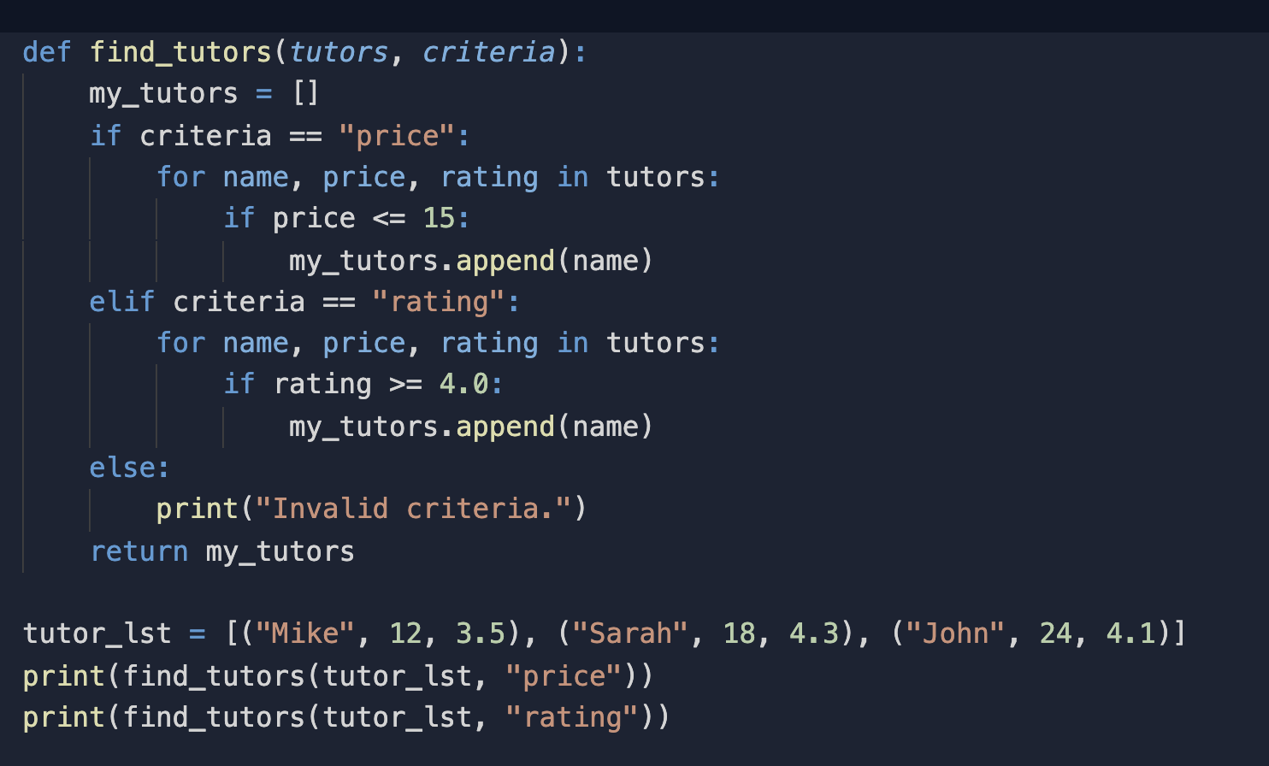
Example 1(Procedure example):

Slide 24
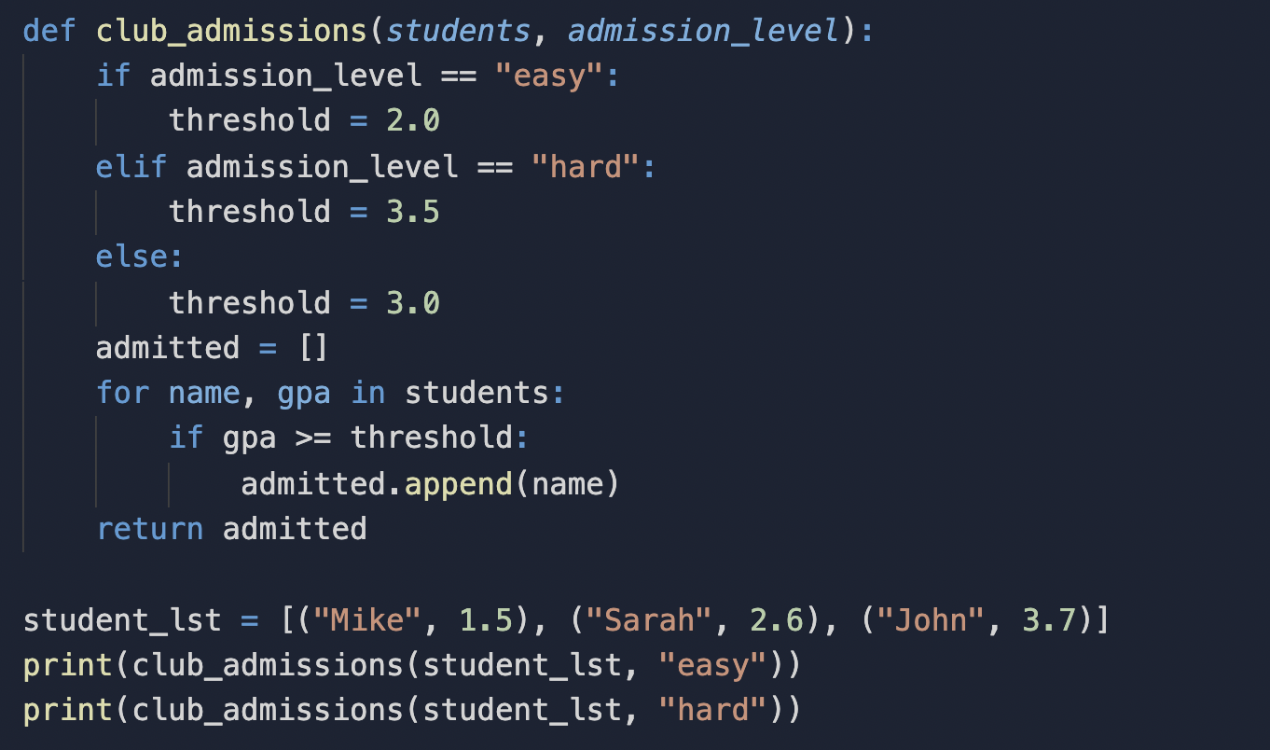
Example 2(Procedure example):

Slide 25
Some Ideas
We did a lab on Alcohol Consumption. That dataset and many other interesting datasets can be found on Kaggle(https://www.kaggle.com/datasets). Find a dataset that is interesting and use it to do something similar like the Alchohol consumption lab. Datasets on Kaggle tend to include many columns; it might be necessary to delete most of the columns and keep only a few.
Kaggle datasets are in a nice csv file format. If you are looking for data elsewhere, you might need to convert your dataset to a text file. More examples: NFL quarterback statistics, NBA statistics, market capitalization or stock prices of companies, cars data, climate data, etc…
Write a game or app using Processing.

Slide 26
Due Wed Feb 12
1) Complete the Create Task proposal on Google classroom. I will check in with everyone this week. You need to know what you are doing for the Create Task before the break.

